Slide 1
Real Estate Development and Entrepreneurship Professor Ben Atkins
Session 4
IRR, Mortgages, Zoning
and Pinckney Street

Slide 2
For Next Week
READ THE LEGAL CASE AND BE PREPARED TO DISCUSS IN CLASS

Slide 3
IRR (Internal Rate of Return)
A measure of an investment’s rate of return
Used in real estate pro formas to estimate the profitability of potential investments

Slide 4
Key IRR Concepts
It is a stream of Cash Flows (positive and negative)
Begins in Period 0 – The Equity invested at Purchase
Measures the Equity invested in the Deal (can be levered or unlevered)
Must have an Exit Date and Value
Very Time Sensitive!
- Shorter hold periods almost always mean higher IRR BUT lower Equity Multiple on cash flow deals

Slide 5
Internal Rate of Return
Model
Sources |  | Uses
Debt | $650 | Price |  | $650
Equity | $350 | Closing Costs |  | $100
 |  | CapEx |  | $250
Total Sources | $1,000 | Total Uses |  | $1,000
 |  |  | Year 1 | Year 2 | Year 3 | Year 4 | Year 5
Rental Income |  |  | $100 | $105 | $110 | $115 | $120
Opex |  |  | ($35) | ($37) | ($39) | ($41) | ($43)
NOI |  |  | $65 | $68 | $71 | $74 | $77
Debt Service (6% IO) |  |  | ($39) | ($39) | ($39) | ($39) | ($39)
CapEx |  |  | ($250)
CFAF |  |  | ($224) | $29 | $32 | $35 | $38
Exit Cap Rate |  |  |  |  |  |  | 7.00%
Total Sales Proceeds |  |  |  |  |  |  | $1,100
Debt |  |  |  |  |  |  | ($650)
Closing Costs (4.0%) |  |  |  |  |  |  | ($44)
Net Proceeds |  |  |  |  |  |  | $406
Total Net Income |  |  | ($224) | $29 | $32 | $35 | $444 | $406+ $38
 |  | Year 0 | Year 1 | Year 2 | Year 3 | Year 4 | Year 5
IRR | 13.88% | (100) | ($224) | $29 | $32 | $35 | $444
Total Proceeds | $540
Profit Multiple | 1.54
Standard Measure of Deal Value
Notes:
1. Loan amount will be lesser of two

Slide 6
IRR Workshop Example
A property is purchased for $3,500,000 (assume this is the “all-in” cost with closing costs, legal fees, etc).
The Project Sources are $2,500,000 in debt and $1,000,000 in equity.
Your Pro Forma projects a sale price at the end of Year 5 based on an Exit Cap Rate of 7%. Assume sales closing costs of 4% of the gross sale price
For the 5 years, assume project gross income will be (000):
$500, $550, $600, $650, $725
Assume operating expenses are (000):
$300, $325, $350, $375, $400
The $2,500,000 loan has an interest rate of 5.5% per year and 30 year amortization
Calculate NOI, Debt service, CFAF, Year 5 Sale Price and Net Sales Proceeds and then the IRR for the Deal

Slide 7
Calculating Debt Service - PMT (Excel)
To calculate the monthly constant (principal and interest)
Use Excel Fn: PMT
Inputs
Rate (interest rate / number of payments per year)
Nper (number of periods; for 30 years, use 360)
PV (present value; full amount of loan)
FV (Future value; if self-amortizing, use 0)
Type (1 or 0; if paid at end of each period, use 0)
Example: (.08/12, 360, 1200000, 0, 0)

Slide 8
Result: $14,195 per month or or annually $170,340 annually

Slide 9
Note reduced loan balance in Year 5 due to amortization
This is “forced savings” that you get back at sale as additional equity

Slide 10
IRR calculation
PERIOD 0 value?
IRR = ?

Slide 11
IRR calculation
IRR (D24:I24) = 22.11%
Note 1: There are no transaction costs in this IRR Calculation (closing costs, sales costs, etc).
Note 2: This is a “Deal Level” analysis (pre-tax, pre-investor waterfall)

Slide 12
IRR vs. Equity Multiple Example

Slide 13
Mortgages
Why do we mortgage our properties?
How much debt should we put on a property?
How do we source mortgages?

Slide 14
Why do we Mortgage our Properties?
To increase the equity we have available
Most developers have a finite supply of equity
To increase the amount of the deal we “own”
Example, if the sponsor is investing $200,000 in property that costs $1 Million, and can borrow 50%, the percentage ownership increases from 20% to 40%.
Note – Sponsor % ownership only increases if they are investing their own equity
To increase our returns
Positive leverage

Slide 15
Positive Leverage
When the unleveraged return on a property is higher than the interest rate on the debt borrowed
When placing debt on a property improves the overall rate of return.
 | All Cash | Leveraged
Purchase Price | $1,000,000 | $1,000,000
Annual Return before Debt Service @ 8% | $80,000 | $80,000
Down Payment | 100% | 30%
EQUITY INVESTED | $1,000,000 | $300,000
Loan (assumed 70% over 30 Years) | $0 | $700,000
Annual Debt at 6.5% Loan Constant | $0 | $45,500
Annual Net Cash Flow (CFAF) | $80,000 | $34,500
Return on Equity | 8.00% | 11.50%

Slide 16
Negative Leverage
When the unleveraged return on a property is lower than the interest rate (including amortization i.e. the “loan constant”) on the money borrowed. The result is a decrease in your return (i.e. your ROE is lower than your unleveraged cap rate)
 | All Cash | Leveraged
Purchase Price | $1,000,000 | $1,000,000
Annual Return before Debt Service @ 8% | $80,000 | $80,000
Down Payment | 100% | 30%
EQUITY INVESTED | $1,000,000 | $300,000
Loan (assumed 70% over 30 Years) | $0 | $700,000
Annual Debt at 9.5% Loan Constant | $0 | $66,500
Annual Net Cash Flow (CFAF) | $80,000 | $13,500
Return on Equity | 8.00% | 4.50%

Slide 17
Negative Leverage (cont.)
Not always bad!
Deal may have negative leverage initially due to development but will become positive after stabilization
Deal may ALWAYS be negative (i.e. a condo project) but will generate desired IRR at exit

Slide 18
How much debt?
Depends on the project and your risk level
More debt – more annual debt service = more financial burden on the property
Harder to absorb market downturns and negative changes to pro forma
Most developers that go broke do so because projects are overleveraged!!!

Slide 19
Two Examples- $1 Million in Equity
Example 1 | Example 2
One Property for $1 Million Total | 10 properties for $1 Million Total
All Cash Purchase | Each property 100,000 Cash and $900,000 debt
Opex $50,000 | Opex $500,000 ($50,0000 x 10)
Sale at Year 2 for $2,050,000 | Debt Service at 6% = $540,000 ($54,000 x 10)
 | Sale at Year 2 for $20,500,000 ($2,050,000 x 10)
Profit = $1 Million | Profit = $9,560,000

Slide 20
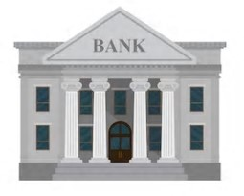
How do we source mortgages?
Direct relationships with banks
Mortgage brokers
They have multiple bank relationships
You can leverage off their relationships
They can help format underwriting materials
Generally charge 1% of Mortgage amount (paid at loan closing)
Seller Financing*
Often best option if you can get it
Sometimes ONLY option for difficult properties
Cheapest to put in place
No guarantees
Often interest only (lower rate without amortization)

Slide 21
Some Key Mortgage Terms
“Loan Constant” – The “effective” interest rate on a loan. Formula is:
total annual debt service (interest and principal) / loan amount
Loan to Value” Ratio (“LTV”) – A percentage ratio calculated as:
loan amount / fair market value of the property
FMV generally determined by an appraisal
In BOE analyses, it is sometimes calculated as:
loan amount/Purchase Price
Lenders have LTV parameters based on the type of loan and type of property

Slide 22
Key Mortgage Terms (CONT.)
Loan to Cost” Ratio (“LTC”)
A percentage ratio calculated as:
loan amount / the total project costs
Used by lenders to determine the amount they are willing to finance in projects with significant renovations or construction
Total project costs include: purchase price, closing costs, brokerage fees, projected capex, annual carrying costs, etc.

Slide 23
Key Mortgage Terms (CONT.)
Debt Service Coverage Ratio (“DSCR”) – a ratio generally calculated as:
net operating income / total annual debt payments
Its a measure of the cash flow available to pay the debt service on a loan.
the ratio states NOI as a multiple of total debt payments due within one year,
Example, if a property has a loan of $1,200,000, and a Loan Constant of 6%,the total annual payments are $72,000. If the NOI of the property is $100,000, the DSCR is 1.39 ($100,000/$72,000)
Lenders will often base a loan size on the lower of a certain LTV percentage or DSCR
The HIGHER the DSCR, the safer for the lende

Slide 24
Example 1 – Cash Flow Property
Purchase Price- $1,500,000
NOI - $90,000
Fair Market Value (by appraisal) – Bank will determine by applying a 5.5% Cap Rate to NOI
Question #1 – What is the FMV?
Question #2- If a lender is willing to loan you 75% LTV (based on FMV), what is the loan size?
Question #3 – Assume a Loan Constant of 6%. A lender is willing to loan you the lesser of 75% LTV or a 1.4 DSCR. What is the loan size?

Slide 25
Example #1 Answers
Question #1 –
FMV = $90,000/.055 = $1,636,364
Question #2 –
$1,636,364x.75 = $1,227,273
Question #3 –
DSCR Maximum of 1.4. $90,000 / 1.4 = $64,285,71. This is the most you can have in annual debt service. Loan Constant is 6%. $64,285.71 / .06 = $1,071,429. This is the loan size under the DSCR Test.
Since loan will be lower of 75% LTV or a 1.4 DSCR, loan size will be $1,071,429

Slide 26
Example # 2 – Construction Project
Purchase Price of $1,850,000
Two Year Project
Closing Costs – 4% of Purchase Price
Carrying Costs - $100,000 per year
Projected Capex - $300,000 in Year 1, $300,000 in Year 2
Loan Amount – 60% LTC
Question #1 – What is the loan amount?
Question #2 – How much equity will you need for this project?

Slide 27
Example #2 Answers
Question #1 – Total Cost = (1) Purchase Price of $1,850,000 + (2) $74,000 in Closing Costs + (3) $200,000 in Carrying Costs + (4) $600,000 in Capex = $2,724,000 *.6 = $1,634,400 loan.
Question #2 – Equity Needed = $2,724,000 - $1,634,4000 = $1,089,600.

Slide 28
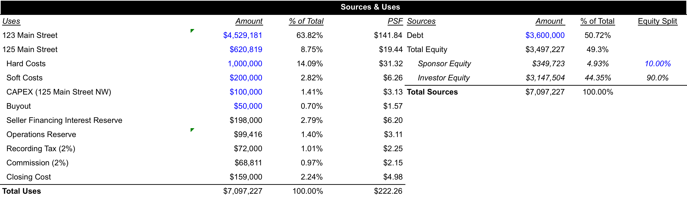
Sources and Uses Table
Make sure you have one!
Make sure they add up!

Slide 29
Zoning and FAR
The 1961 Zoning Resolution divided New York City into residential, commercial, and manufacturing areas
Different areas have different permitted uses and FAR
How do you find out the zoning for a site?
Look at the NYC’s zoning maps
Websites like oasisnyc (free) and propertyshark will also tell you
The FAR and permitted uses for that zoning an be found in the NYC Zoning handbook
Multiple the FAR by the lot size to determine how much you can build

Slide 30
Three Main Zoning Classifications
R – Residential
M – Manufacturing
C – Commercial
Higher numbers generally mean higher density
NYC Zoning Map - https://www1.nyc.gov/site/planning/zoning/index-map.page
NYC ZOLA

Slide 31
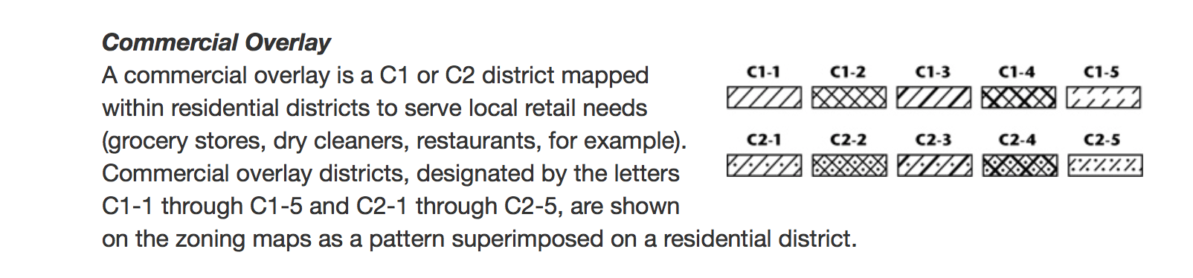
Overlays
Permit multiple uses in a zone
i.e. Commercial uses in an R zone
Note – They may have different FARS for the different uses

Slide 32
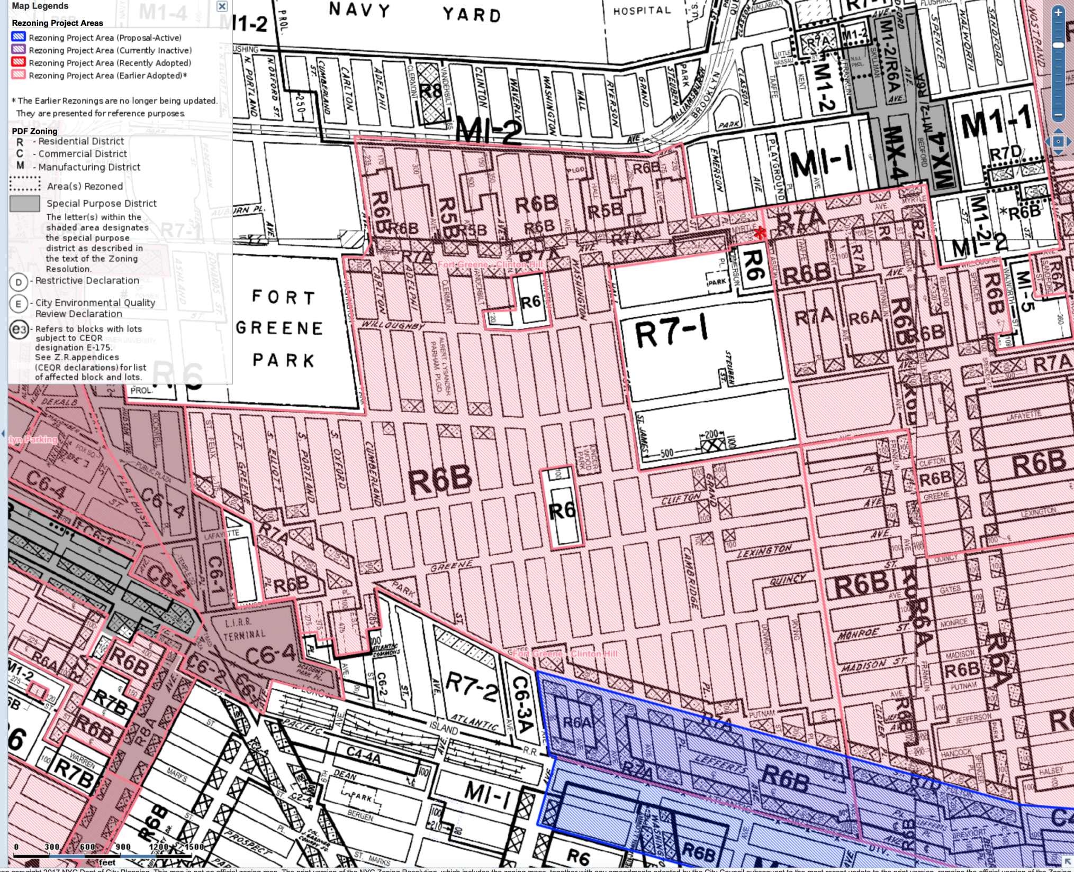

Slide 33
Things to Note
Are their any impediments to using the FAR from a site?
Lot size (too small, bad layout), Landmarks or historic district designation, site conditions (existing structures, grade changes), other site issues
Unused Air Rights
If you don’t plan to use, can you sell them?
Can only be transferred to an adjoining neighbor or through a “daisy change”
Usually sell at at steep discount to normal development site rights pbsf

Slide 34
Pinckney Street Case
Evaluation of the Property
Search Process to Find and acquire a small income-producing property
Quantitative Considerations
Underwriting process
Examination of assets
Available cash and leverage
Qualitative Considerations
Should Edward approach real estate development as a sideline business?
Is this a good first deal?
Is he taking into account all of the issues involved?

Slide 35
Why is Edward doing this deal?
Experience
Capital Appreciation
Expanding his contacts
“Free” Place to live
Is this true?

Slide 36
Evaluation of the Property
EDWARD’S SEARCH METHOD
US Census data
local maps
Internet sites and searches
Boston newspapers
industry advertisements
lots of legwork inspecting buildings and interviewing tenants
Brokers
potential for conflicts?

Slide 37
Evaluation the property
Pros
location
market
Cons
physical condition of the building
in historic district designation
regulatory environment; in NYC called Landmark designation
construction risk
reliability of the estimates
vagaries of soft costs
establishing an operating statement with guesswork

Slide 38
Evaluation of the property
Issues:
He caught-up in the excitement to do a deal
Always be careful of trying to make the deal work
Constantly re-analyze in light of original goals
Unrealistic/risky approach
Belief that he can renovate cheaper than outside contractor and architect
Belief that the true cost of the work can be forecast exactly
No financial cushion
Personal credit issue if deals goes bad

Slide 39
Quantitative Considerations
What are his assets?
$240k in cash
Wants to grow his $240k savings through a leveraged investment in what he believes to be an emerging market
Knowledge of the Boston area
has directed him to Beacon Hill, one of the best residential neighborhoods
Willingness to work hard and take risks
Knowledge of construction
Is it enough?

Slide 40
Quantitative Considerations
Financing alternatives
Take over existing $1,000,000 mortgage
Get new mortgage for $1,050,000
$200k second mortgage from Seller –Feasible?
Operating and Capex
Live in the building
Do the work himself
Capital Appreciation
Long-term appreciation and rent growth
Sell as condos?

Slide 41
The Set-up
Gross Income $157,200
Less vacancy (5%) ($7,860)
Net Income (EGI) $149,340
OPEX ($32,201)
RE taxes ($14,645)
NOI $102,494
_________________________________ (the “line”)
Debt Service $1M 1st ($57,290)
$200k Seller 2nd ($12,884)
Total Debt Service ($70,174)
CFAF $32,320

Slide 42
Financial Analysis
$1 Million Loan
Sources of funds
1st Mortgage $1,000,000
2nd Mortgage $200,000
Equity (savings) $240,000
$1,440,000
Uses of funds
purchase price $1,000,000
remodeling $450,000
carrying (6 mo.) Opex $11,323
lawyers -
loan origination fee -
tax escrow $2,441
Total costs $1,483,763
Equity required $283,763
Equity shortfall ($43,763)
If everything goes right!!!!!
Note: approx. $16,000 shortfall even with the $1.5 Million loan due to the loan costs

Slide 43
Edward’s Plan for Cash Shortfall of $43,763?
Reducing remodeling costs by doing it himself
Reduce carrying costs by doing the work faster (?!!?)
NOT a pro
Has a full time job
Crew of one
No reserves for capital uncertainties (roof, boiler, etc.)
Scale issue
with only four units, normal deviation from expected numbers cause large problems
Unknowns
RE taxes may also increase because of reassessment
Landmarks

Slide 44
Qualitative Issues
Time commitment at this stage in his career
Impact on job and personal life
Limited financial resources
staying power if market softens, cost overruns, vacancies etc.
Personal liability exposure
Other personal considerations
Living in an investment

Slide 45
Opinion of the deal
Project might be better for someone with more assets/cash
Too little margin for error for first deal?
If market stays strong, he may be fine, but risk/reward calculus suggests pass

